Slide 1

THE HISTORY OF WI-FI

Slide 2

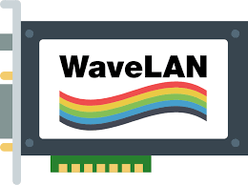
Network standard
Release of wavelan
1971
1985
1990
1973
1988
Open network use
Father of wi-fi
The presentation

Slide 3
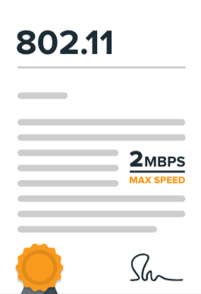
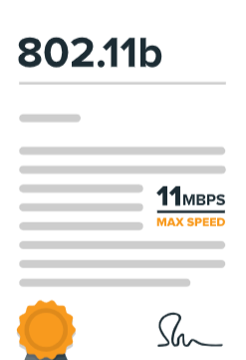
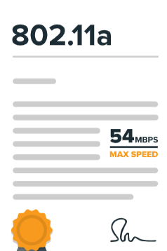

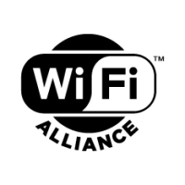
802.11protocol
802.11b protocol
1993
1999
2000
1997
1999
Public hotspot
802.11a protocol
Wi-fi alliance

Slide 4
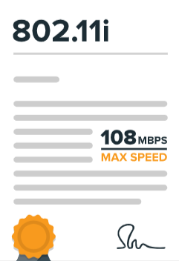
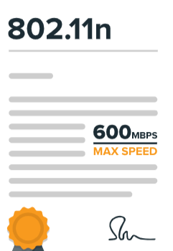
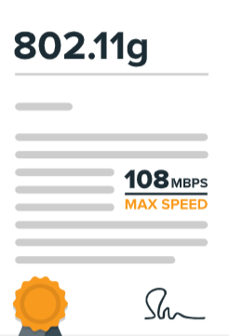
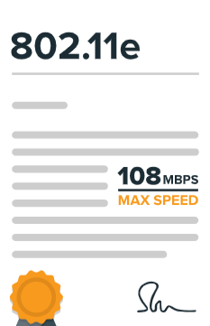
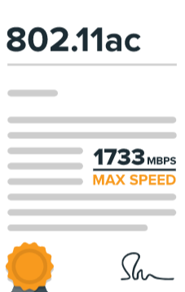
802.11i protocol
802.11n protocol
2003
2005
2014
2004
2009
802.11g protocol
802.11e protocol
802.11ac protocol

Slide 5
802.11 Architecture

Slide 6
Application
HTTP, FTP, SMTP etc.
DHCP, RTP, TFTP, etc.
Host
TCP
UDP
IP
802.2 Logical Link Control (LLC)
802.11 Media Access Control (MAC)
Radio
Physical Layer (PHY)
(802.11b DSSS, 802.11g OFDM, 802.11n MIMO etc.)

Slide 7
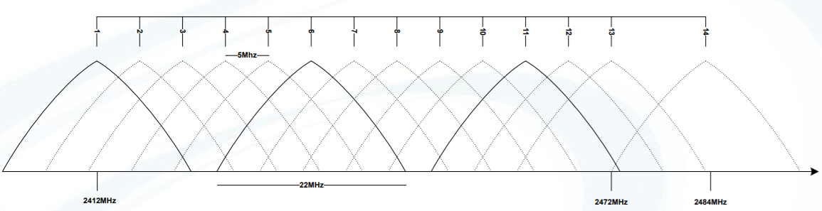
Physical Layer
2.4 GHz and/or 5GHz transceiver
Spread spectrum technology
FHSS (Frequency Hopping Spread Spectrum)
DSSS (Direct Sequency Spread Spectrum)
OFDM (Orthogonal Frequecy-Division Multiplexing)
Europe: channels 1-13
USA: channels 1-11
Japan: channels 1-14

Slide 8
Physical Layer
Standard
Frequency
Bandwidth
Symbol rate (Mb/s)
802.11
802.11a
802.11b
802.11g
802.11n
2.4GHz
5GHz
2.4GHz
2.4GHz
2.4/5GHz
20
20
20
20
40
20
1,2
6, 9, 12, 18, 24, 36, 48, 54
5.5,11
6, 9, 12, 18, 24, 36, 48, 54
7.2, 14.4, 21.7, 28.9, 43.3, 57.8, 65, 72.2

Slide 9
Media Access Control (MAC)
Function | Explanation
Scanning | Scanning of access points. Both active (probe) and passive (beacon) scanning are provided by the standard.
Authentication | Authentication is the process of proving identity between the client and the access point.
Association | Once authenticated, the client must associate with the access point before sending data frames.
Encryption | Encryption of payload
RTS/CTS | The optional request-to send and clear-to-send (RTS/CTS) function allows the access point to control use of the medium for stations activating RTS/CTS.
Power Save Mode | The power save mode enables the user to turn on or off enables the radio.
Fragmentation | The fragmentation function enables an 802.11 station to divide data packets into smaller frames.

Slide 10
Logical Link Control (LLC)
The LLC provides end-to-end link control over 802.11-based wireless LAN
LLC services:
Unacknowledged connectionless service
Connection-oriented service
Acknowledged connectionless service

Slide 11

Application
HTTP, FTP, SMTP etc.
DHCP, RTP, TFTP, etc.
TCP
UDP
IP

